Slide 1




Smokey: Ubiquitous Smoking Detection with Commercial WiFi Infrastructures
Xiaolong Zheng, Jiliang Wang, Longfei Shangguan, Zimu Zhou, Yunhao Liu
Notes:
Thank you for the introduction. Good afternoon, everyone. My name is Zheng Xiaolong, from Tsinghua University. Today, I’ll present Smokey, an ubiquitous smoking detection method with commercial WiFi infrastructures. This is a joint work with Princeton University and HKUST.

Slide 2
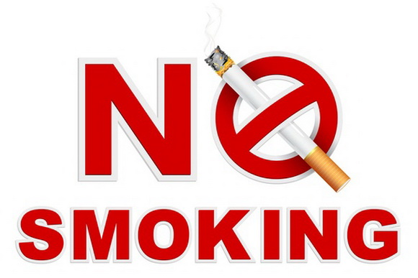
Motivations
Smoking ban is put into effect in many countries
Notes:
It is well known that smoking is not only a significant reason of death and disease, but also a leading cause of fire disaster.
In modern society, indoor smoking ban is put into practice in many countries to prevent the health influence to other non-smokers and also prevent the fire disaster.

Slide 3
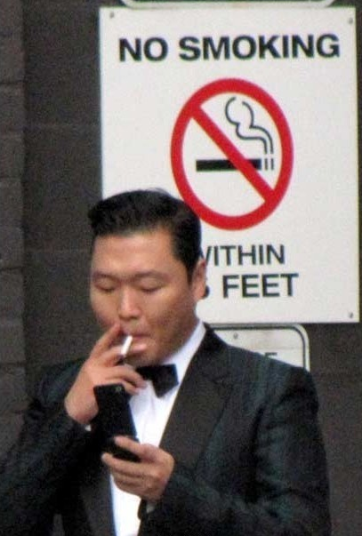
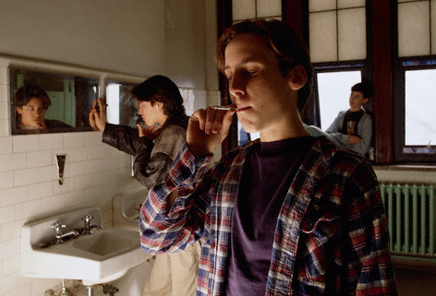

Motivations
However, what do the civilized people do?
Notes:
However, it is not easy to detect the violations of the smoking ban.
You may have the experience that some people smoking in the toilets and stairwells.
They even smoke just near the warning notices like this famous man does.
Therefore, a monitoring system is necessary to ensure the smoking ban really benefits.

Slide 4
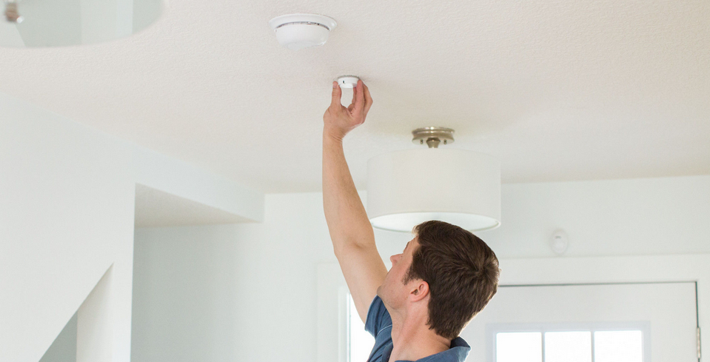
How to monitor and detect?
Fire alarm system
Smog sensors
Not sensitive enough to detect smoking a cigarette
Notes:
But how to detect and monitor the smoking activities?
In modern building, smog sensors are widely deployed. However, it is not sensitive enough to detect the small amount of smoke caused by smoking a cigarette.

Slide 5
How to monitor and detect?
Customized sensors
carbon monoxide
Nicotine
Impractical to be ubiquitously deployed
Limited sensing range of each sensor
Expensive
Notes:
Some customized sensors are proposed. However they have a limited sensing range and expensive, making it impractical to widely deploy.

Slide 6
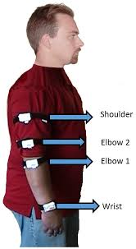
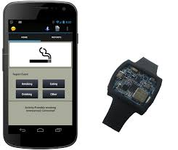
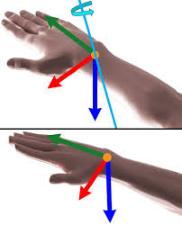
How to monitor and detect?
Wearable devices
Inertial sensors
Analyze: chest motions, wrist motions, arm motions…
Require targets to wear dedicated devices
Notes:
Recently, researchers use wearable devices to detect and record the smoking activities for helping the smokers quit smoking.
They require the targets to wear dedicated devices with sensors such as chest and wrist bands. It is impossible for our scenarios where the potential targets will not cooperate.

Slide 7
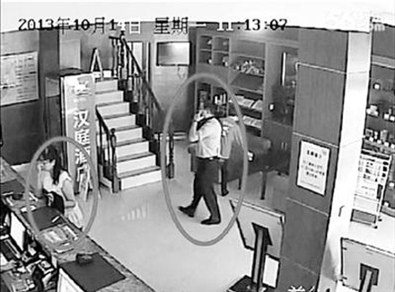

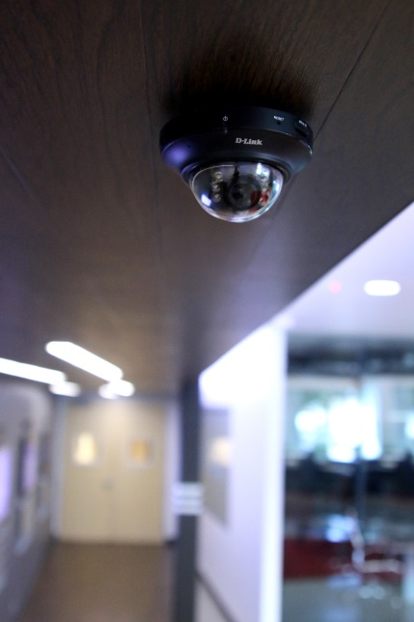
How to monitor and detect?
Computer Vision (CV)
Surveillance cameras
Detect the cigarette or the body movements
Require clear and line-of-sight (LOS) video images
Notes:
Computer Vision techniques can leverage the cameras to detect the cigarette or specific body movements.
But they require the line-of-sight video images.
Due to the cost and privacy concerns, some places such as stairwell and toilets cannot use such method.
But such places happen to be the places where invalid smoking often happens.

Slide 8
Motivation
Desired Smoking Detection System
Non-intrusive: without requirements of wearing devices
Ubiquitous: without the limitation of LOS scenarios
Accurate: detect invalid smoking activities
Notes:
In a nutshell, existing methods fail to provide our desired smoking detection system which should be non-intrusive but able to automatically and accurately detect the invalid smoking activities under a wide range environments including both LOS and Non-LOS conditions.

Slide 9
Wireless signal?
Human motions affect wireless signal
Localization & TrackingControl system: virtual mouse, AllSee, WiGesture, et al.
Users’ involvement and compliance required
Is that possible to leverage the affected WiFi signal to infer smoking activities?
Without the requirement of users’ compliance
Under various dynamic environments
Notes:
Recent studies have shown that human motions affect wireless signal. Hence, we turn to thinking solutions in this direction.
Existing methods train the model with labeled data to infer the user’ motions.
But in our scenario, there are various monitoring environments and too many potential monitoring targets. No labeled data is available.
Hence, we may ask is that possible to leverage the affected WiFi signal to detect smoking activities under various dynamic environments, without the requirement of users’ cooperation?
To answer this question, we preform some preliminary analysis and experiments.

Slide 10
Smoking steps
Smoking is a rhythmic activity
Holding
Put up
Suck into
mouth
Put down
Inhale
Exhale
Notes:
First of all, let us have a look at the smoking steps.
According to Wiki, smoking usually has six steps. After lighting up a cigarette (C个right) , the smoker holds it most of the time in step (a) and occasionally performs actual smoking motions from b to f. The smoker first puts up the cigarette to the mouth and then such the smoke into mouth, then the smoker puts down the cigarette and inhale the smoke quickly and then slowly exhale.
Then the smoker keeps holding the cigarette and repeats Step b to f.

Slide 11
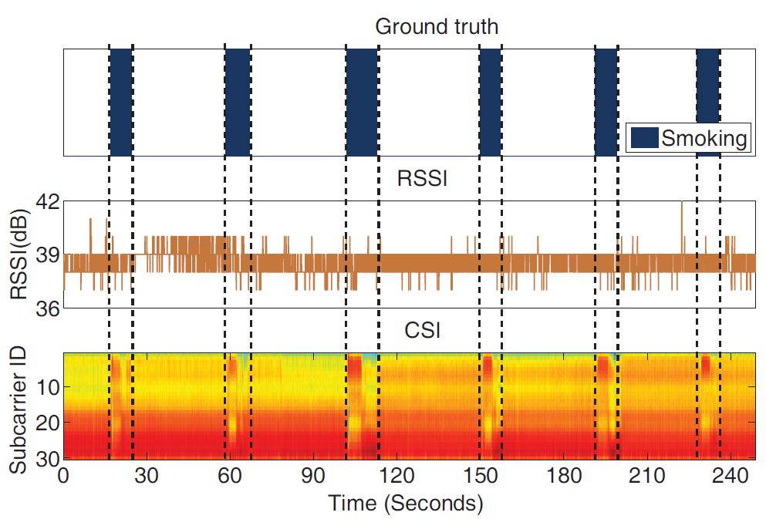
Smoking affects WiFi CSI
Channel State Information (CSI)
Notes:
So we can see smoking contains arm and chest motions. Then we verify whether such arm and chest motions affect WiFi signal or not.
The figure presents the RSSI and CSI sequences collected during smoking.
We can find the changes of CSI have positive correlations with the smoking activities.

Slide 12
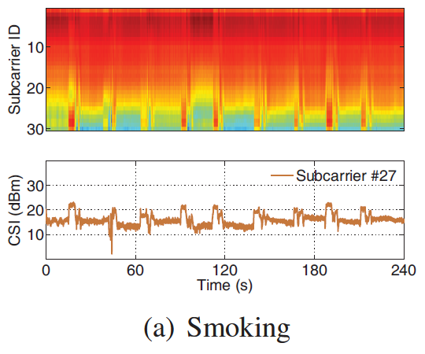
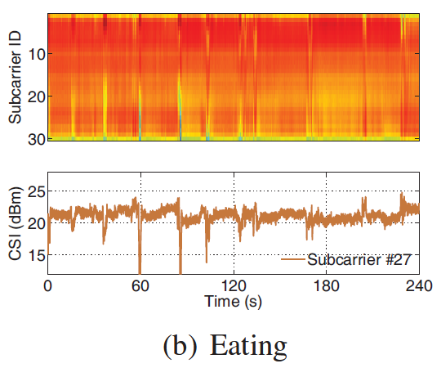
Distinctive smoking
Smoking is rhythmic activity
Smoking is a composite activity that contains a series of motions in a certain order
Notes:
The analysis above show that smoking causes WiFi CSI variance. But smoking is not the only reason for CSI variations. In daily life, other activities such as eating, drinking and deep breathing also have arm and chest motions. We then study whether smoking is distinguishable.
First of all, as shown above, smoking is a rhythmic (瑞斯梅克) activity. The time interval between two successive smoking motions depend on individual smokers and it is relatively stable during one cigarette smoking. While other activities seldom have such stable rhythm.
Second, smoking is a composite (啃泡贼特) activity that contains a series ( C瑞斯 ) of motions in a certain order. While others are usually not. We can see from the red circles. Each smoking has two CSI changes, one is caused by arm motions and the other one is caused by chest motions.

Slide 13
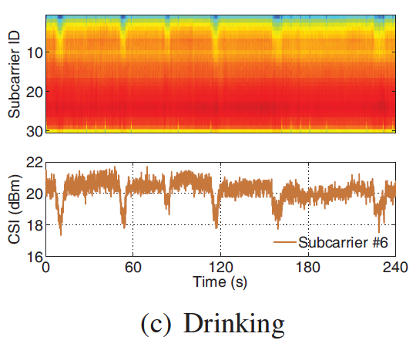
Distinctive smoking
Smoking is rhythmic activity
Smoking is a composite activity that contains a series of motions in a certain order
Notes:
We can see comparing to drinking and deep breathing, same observations can be found.

Slide 14
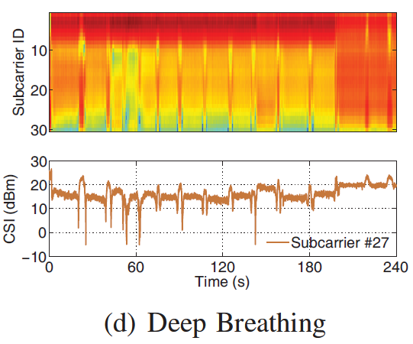
Distinctive smoking
Smoking is rhythmic activity
Smoking is a composite activity that contains a series of motions in a certain order

Slide 15
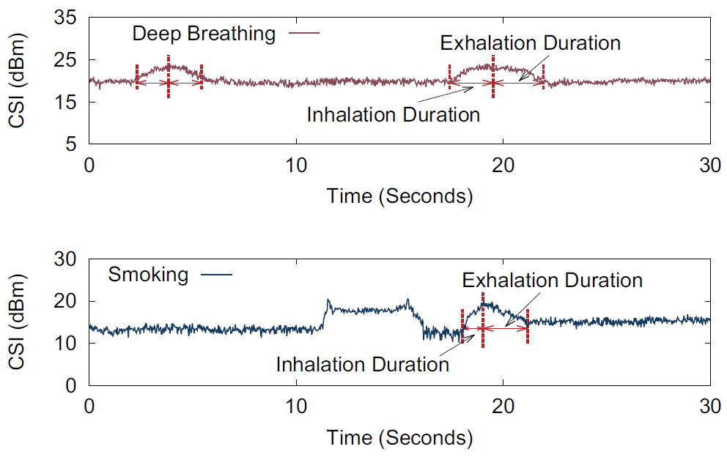
Unique chest motion
Exhalation is longer than inhalation
(a) Deep breathing
(b) Smoking
Notes:
During the experiments, we also find that the chest motion during smoking is unique, which helps to detect smoking.
The figure presents the CSI on a single subcarrier during deep breath and smoking. The x axis is time and y axis is CSI amplitude. Figure a is deep breathing and b is smoking.
Notice that the smokers usually inhale quickly and exhale slowly to absorb more nicotine（你可听） for the pleasure.
Hence, the exhale time is longer than inhale time during smoking, which is unique.

Slide 16
Micro-benchmark
Desired Smoking Detection System
Non-intrusive: without requirements of wearing devices
Ubiquitous: without the limitation of LOS scenarios
Accurate: detect invalid smoking activities
？
Notes:
Above preliminary results show that it is feasible to use WiFi CSI to detect smoking. The method will be non-intrusive and ubiquitous because wireless WiFi signal is non-intrusive and ubiquitous. However, how accurate the detection can be?

Slide 17
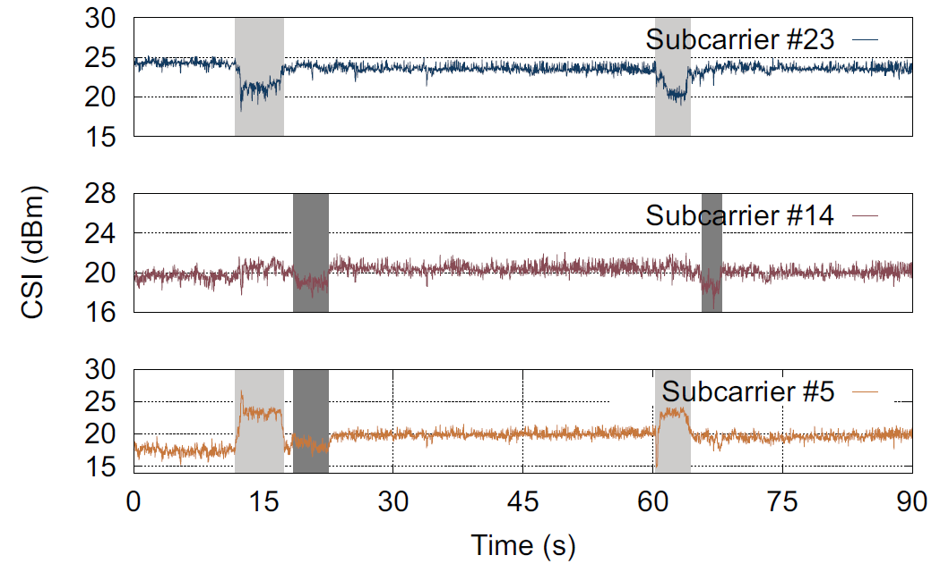
Subcarrier-dependent problem
The impacts of smoking are subcarrier-dependent
The impacts of smoking on CSI vary dynamically on a single subcarrier
Notes:
How to extract the useful information form the noisy CSI trace is important to the detection accuracy. A straight-forward method is selecting some subcarriers in advance. But it is not easy. Using too many subcarriers may bring too much noise and using too little subcarrier may lose important information.
During the analysis, we find that the impacts of smoking on CSI are subcarrier-dependent and dynamic even on a single subcarrier, making the subcarrier selection more difficult.
In this figure, we show the CSI sequences on subcarrier #5, #14, and #23.
Light gray areas are the periods of smoking phase from (b) to (d) with arm motions. Dark gray areas are the periods of smoking phase (e) and (f) with chest motions.
We can find that different subcarriers have different sensitivities to arm and chest motions. And the sensitivity even varies on a single subcarrier.
Therefore, using pre-selected subcarriers as previous method is impossible. How to extract the useful information from the dynamic subcarrier is challenging.

Slide 18
Outline
Motivations
Preliminary Analysis
Design of Smokey
Evaluation
Summary
Notes:
Next, I present the designs of our smoking detection system call Smokey which can accurately identify the good subcarriers to exact the meaning motions under dynamic environments.

Slide 19
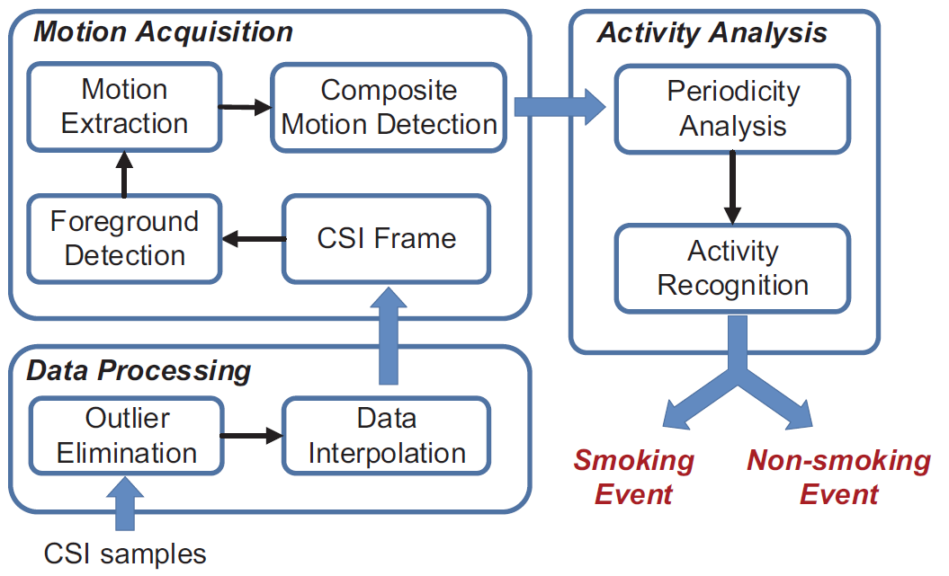
Smokey Overview
Notes:
This is the overview of Smokey. We first process the raw data. Then we borrow the idea of foreground detection methods from computer vision to solve the subcarrier-dependent problem and extract the meaningful motions in Motion Acquisition (爱可谓贼深) Component. I’ll present this key component of our work.

Slide 20
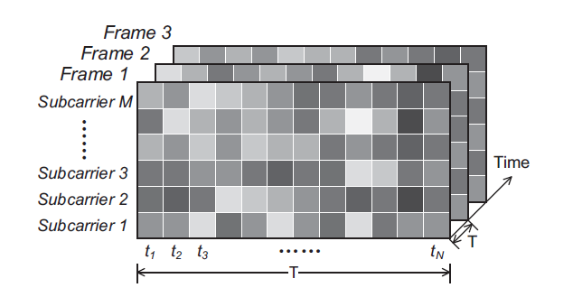
CSI Frame
Construct CSI frames from CSI sequences
Each frame contains M×N pixels
P_{m,n} : CSI amplitude of subcarrier m collected within the n-th time window (t_{n})
Notes:
In computer vision problem, the data should be processed in unit of image frame. In our problem, we should first construct CSI frames from CSI sequences. We divided the sequences into segments to construct CSI images. Then we compare the foreground detection problem with our problem.

Slide 21
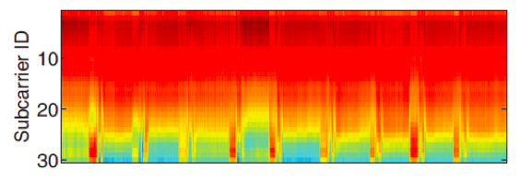
Subcarrier-dependent problem
Foreground Detection
Information Extraction
Moving objects
Foreground
CSI changes caused by smoking
Notes:
Inspired by foreground detection problem in Computer vision research, we formulate our information extraction problem.
In foreground detection problem, the foreground is usually some moving objects. And our foreground can be defined as the CSI changes caused by smoking.
Both foregrounds can be regard as the pixels with significant changes.

Slide 22
Subcarrier-dependent problem
Foreground Detection
Information Extraction
Background model
Adaptive to environment changes such as luminance
Online Update
Background
Mixture of Gaussians
Adaptive to time-varying dynamics
Online Update
Notes:
Foreground detection problem is extracting the moving objects from the dynamic background. Even though the background is changing due to the environment dynamics such as luminance changes, it still can be described by a background model.
In our problem, our background is the noise from different subcarriers, which is also dynamic and be able to described by a model. Give the wireless signal features, the background noise can be described by Mixture of Gaussians.
Inspired by foreground detection problem, we design our motion extraction method.

Slide 23
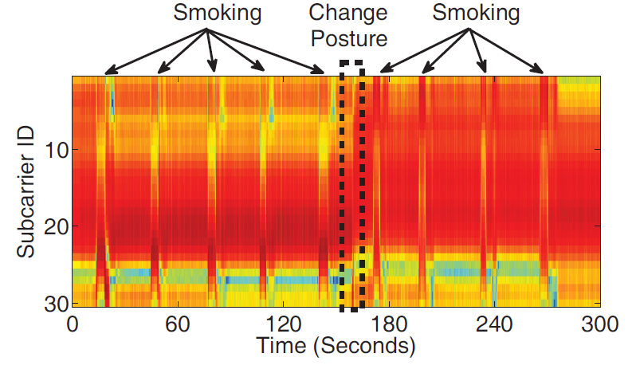
Sample Results
Original CSI trace
Notes:
Here is an example. The figure presents the original CSI trace collected during smoking.

Slide 24
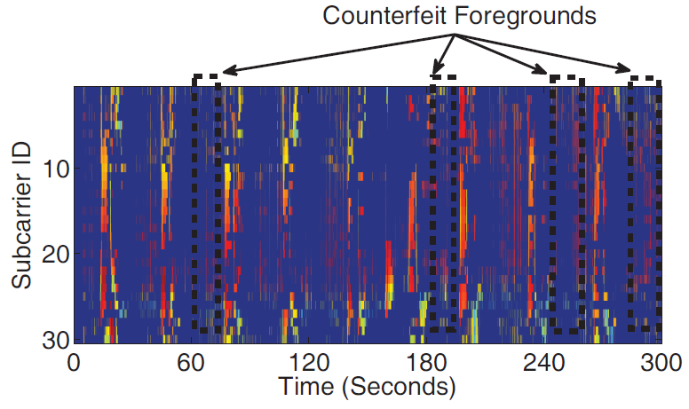
Sample Results
After foreground detection
Notes:
After foreground detection. The CSI foregrounds caused by human motions are extracted. But we can see there are some false positives.

Slide 25
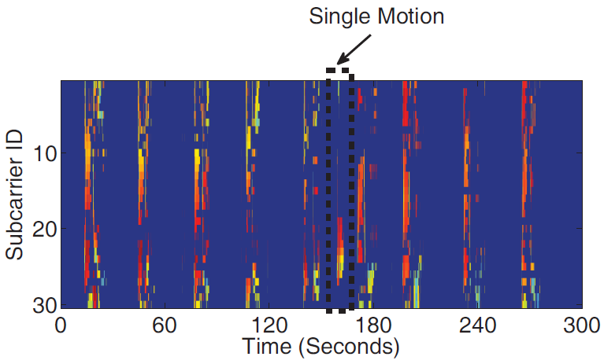
Motion Extraction
Filter out the counterfeit foregrounds
Temporal correlation
Frequency correlation
Notes:
Then we use the temporal correlation and frequency correlation to filter out the false foregrounds. But it still contains the single motion which is caused by a single movement.

Slide 26
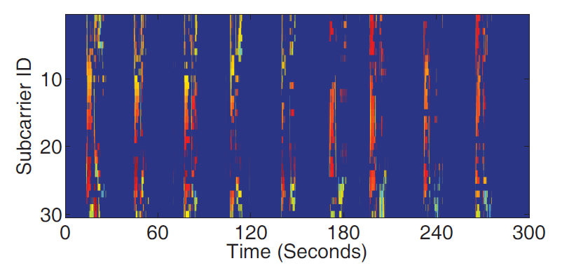
Composite Motion Detection
Filter out the single motion
Notes:
Note the smoking is a composite activity which contains a series of motions. Hence, we filter out the single motions.

Slide 27
Smokey Overview
Notes:
Then we use the extracted information to perform periodicity analysis to find the extracted motions have rhythm like smoking or not.

Slide 28
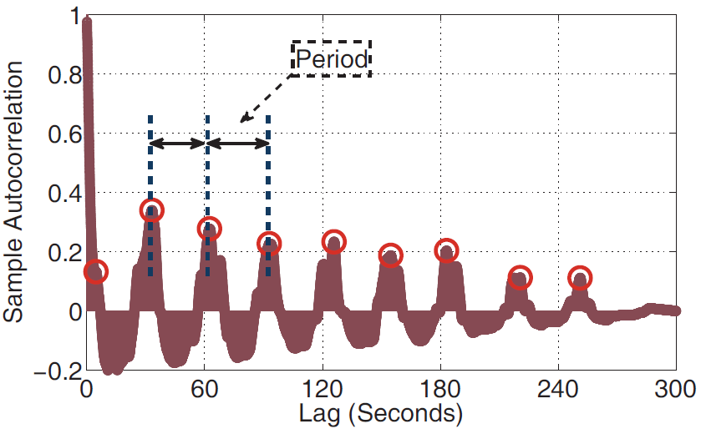
Periodicity Analysis
Autocorrelation
Smoking is a rhythm activity
Notes:
We use autocorrelation to analyze the period. If there is a relatively stable period, we judge there is smoking activity.

Slide 29
Outline
Motivations
Preliminary Analysis
Design of Smokey
Evaluation
Summary
Notes:
To evaluate our work, we perform real experiments.

Slide 30
Evaluation Setting
Hardware:
TP-LINK TL-WR742N wireless router
Mini PC with Intel WiFi Link 5300 NIC with one antenna
Software:
Operate in IEEE 802.11n mode on Channel 11 at 2.4GHz
The receiver pings the transmitter every 30ms
CSI measurements obtained by the Linux CSI tool

Slide 31
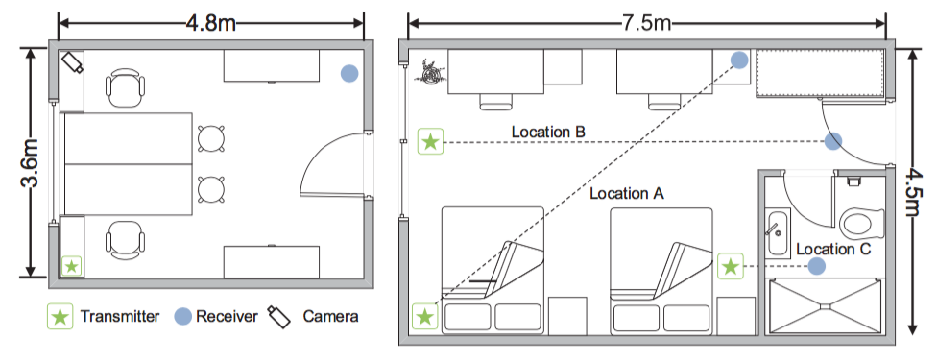
Evaluation Setting
Environments:
Office room where smoking is allowed
Apartment
Notes:
we conduct our experiments in a smoking-allowed office room and two apartments where a smoker and a non-smoker living in respectively.

Slide 32
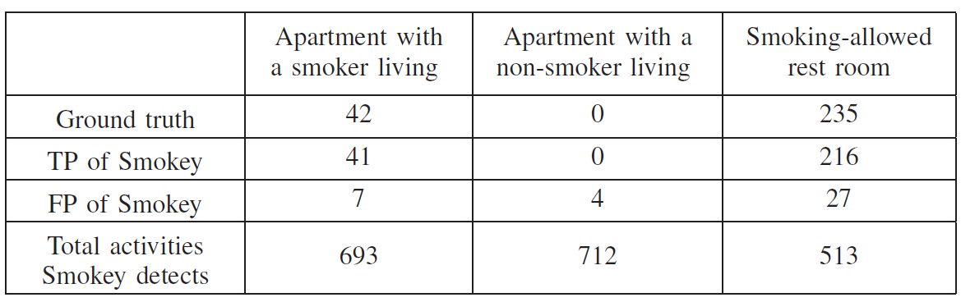
Evaluation Results
Smokey accurately detects 92.8% of the smoking activities and misjudges 2.3% of the normal activities.
Notes:
This is the overall accuracy in three settings. Smokey accurately detects 92 percentage of the smoking activities and misjudges 2.3 percentage of the normal activities as smoking.

Slide 33
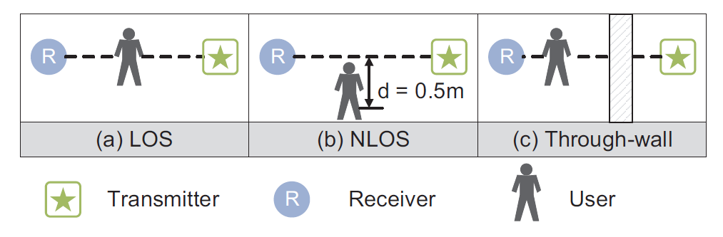
Evaluation Results
Impact of NLOS propagation
Experiment scenarios:
Notes:
We also evaluate Smokey under Non Line of sight and through-wall environments. This is the illustration of our experiment scenarios.

Slide 34
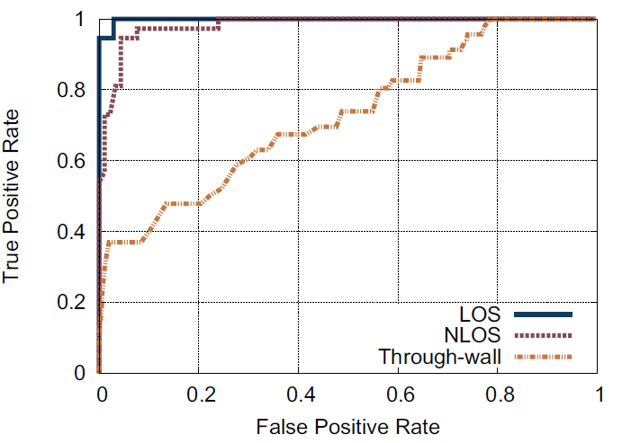
Evaluation Results
Impact of NLOS propagation (FPR=0.01)
LOS: 0.946
NLOS: 0.567
Through-wall: 0.304
Notes:
Given the false positive rate less than 1 percent, the accuracy is 0.946 under line of sight environments.
The accuracy drop to 0.56 and 0.3 under NLOS and through-wall environments respectively.

Slide 35
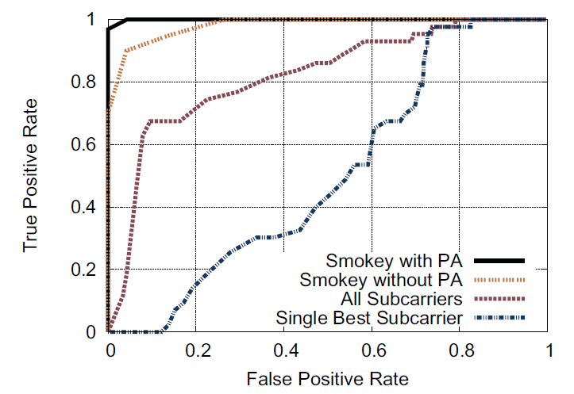
Evaluation Results
Dynamic selection of subcarriers in Smokey improves accuracy
Periodicity analysis improves accuracy
ROC curve

Slide 36
Conclusion
Smokey: Ubiquitous Smoking Detection with Commercial WiFi Infrastructures
Ubiquitous: LOS, NLOS and through-wall scenarios
No-intrusive: without requirement of wearing devices
Accurate with a low false alarm ratio
Accuracy: 92.8% in real deployments
66.7% at 3m (target-to-device distance)
False Positive Rate: 2.3% in real deployments
Notes:
Here is a conclusion of our work. We design an ubiquitous smoking detection method called Smokey. It is a step in moving to no-intrusive and ubiquitous smoking detection system that ensure the smoking ban benefits and avoid the fire hazards. (哈泽儿子)

Slide 37
Smokey: Ubiquitous Smoking Detection with Commercial WiFi Infrastructures
Thank you!
Q&A
Notes:
That is all, Thank you very much for listening!

Slide 38
Data Processing
Outlier elimination
Hampel identifier
x ~ |x−μ| ≤ ε ·σ , wher μ and σ are the median and the median absolute deviation (MAD)
Interpolation
linear interpolation
non-uniformly sampled CSI due to various delays

Slide 39
CSI Frame
Construct CSI frames from CSI sequences
Each frame contains M×N pixels
P_{m,n} : CSI amplitude of subcarrier m collected within the n-th time window (t_{n})

Slide 40
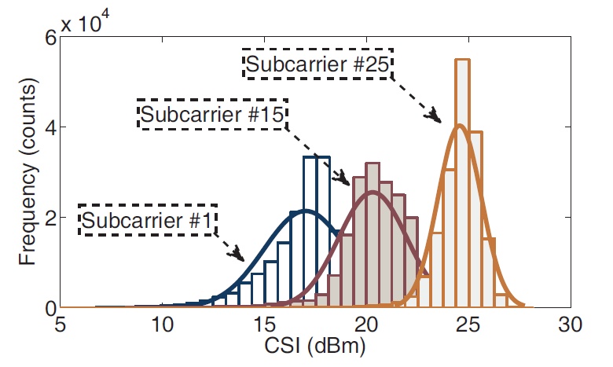
Foreground Detection
Constructing the background model
Mixture of Gaussians

Slide 41
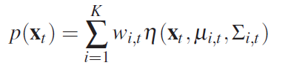
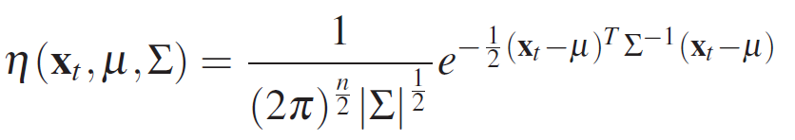
Foreground Detection
Constructing the background model
Probability that a pixel has value x_{t} at time t
K: the number of Gaussian distributions
w_{i,t}: estimated weight of the i-th Gaussian distribution
u_{i,t}: estimated mean of the i-th Gaussian distribution
η : Gaussian probability density function

Slide 42
Foreground Detection
Foreground extraction
Pixel is regarded as foreground when
Its value is more than 2.5 standard deviations away from the K Gaussian distributions

Slide 43
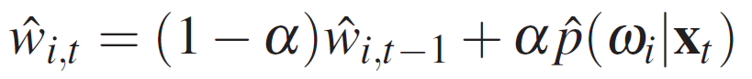
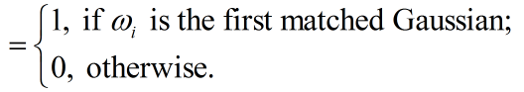
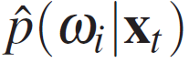
Foreground Detection
Online updating model
Self-adaptive to background changes
The weight of the K distributions are adjusted as
where

Slide 44
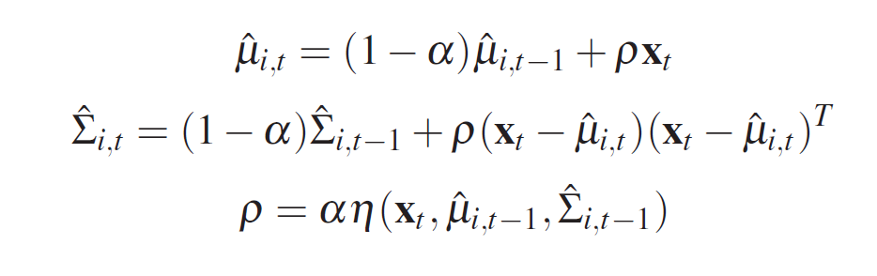
Foreground Detection
Online updating model
Self-adaptive to background changes
μ and σ remain the same for unmatched distributions
For the matched distribution:

Slide 45
Evaluation Results
Dynamic selection of subcarriers in Smokey improves accuracy
Periodicity analysis improves accuracy
ROC curve

Slide 46
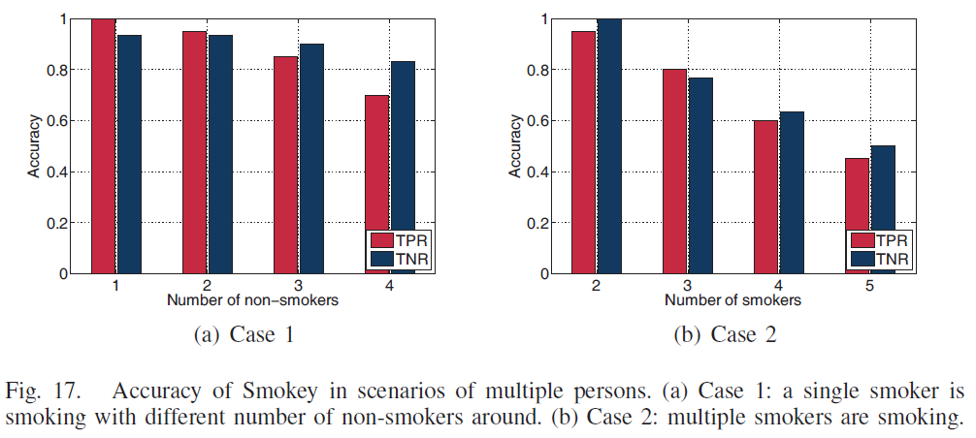
Evaluation Results
Impact of multiple persons
Notes:
We also evaluate Smokey with multiple persons around. The accuracy will drop with the increase of number of persons.
The accuracy is more than 0.7 and 0.4 when there are 4 non-smokers and 4 smokers around respectively.
The accuracy drops faster when multiple smoker smoking in Case 2, compared to the Case1 where one smoker is smoking and chatting with other non-smokers.
This is because the smoking habits of different smokers are different, the periodicity analysis is easier to corrupt.

Slide 47
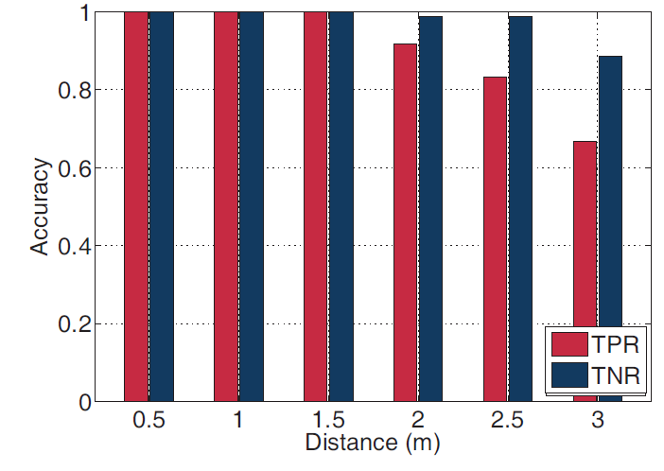
Evaluation Results
Impact of device-to-target distance
At 3m: 0.667 TPR & 0.114 FPR

